Slide 1

OpenCV - Introduction
Part II –Getting Started with VIDEOs
Ref: Taken from
https://opencv-python-tutroals.readthedocs.io/en/latest/py_tutorials/py_tutorials.html

Slide 2
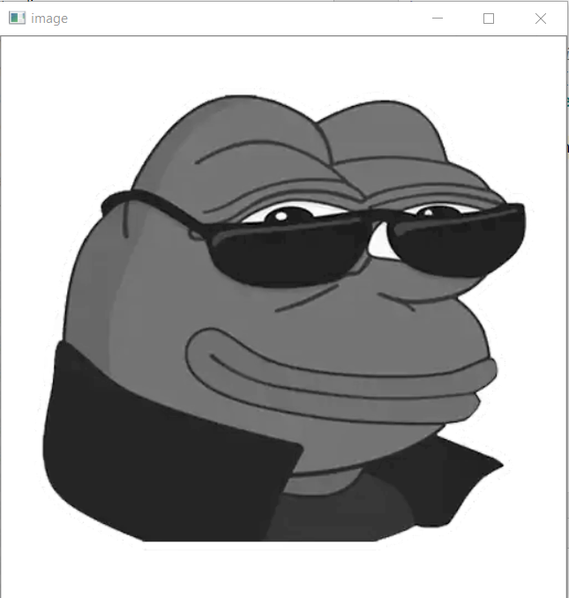
Recap
Writte a program to load an image in grayscale, display it and save the image if ‘s’ is pressed and exit. Or simply exit without saving it when you press ESC key
import numpy as np
import cv2
img = cv2.imread(‘frong.jpg',0)
cv2.imshow('image',img)
k = cv2.waitKey(0) & 0xFF
if k == 27: # of 0x1B wait for ESC key to exit
cv2.destroyAllWindows()
elif k == ord('s'): # wait for 's' key to save and exit
cv2.imwrite('messigray.png',img)
cv2.destroyAllWindows()

Slide 3
Capture video from Camera : cv2.VideoCapture(), cv2.VideoWriter()
import numpy as np
import cv2
cap = cv2.VideoCapture(0)
while(True):
# Capture frame-by-frame
ret, frame = cap.read()
# Our operations on the frame come here
gray = cv2.cvtColor(frame, cv2.COLOR_BGR2GRAY)
# Display the resulting frame
cv2.imshow('frame',gray)
if cv2.waitKey(1) & 0xFF == ord('q'):
break
# When everything done, release the capture
cap.release()
cv2.destroyAllWindows()

Slide 4
Check frame height and width: .get(3) and .get(4)
How ???
Notes:
cap.get(3)
cap.get(4)
print('height %d width %d'%,cap.get(3),cap.get(4))
ret = cap.set(3,1240) ret = cap.set(4,1080)
ret = cap.set(3,1040) ret = cap.set(4,640)
ret = cap.set(3,1920) print(ret) ret = cap.set(4,1080) print(ret)

Slide 5
ROI
roi = gray[y1:y2, x1:x2]
cnts = cv2.findContours(grayscale_image, cv2.RETR_EXTERNAL, cv2.CHAIN_APPROX_SIMPLE)
cnts = cnts[0] if len(cnts) == 2 else cnts[1]
ROI_number = 0
for c in cnts:
x,y,w,h = cv2.boundingRect(c)
ROI = image[y:y+h, x:x+w]
cv2.imwrite('ROI_{}.png'.format(ROI_number), ROI)
ROI_number += 1

Slide 6
from PIL import Image
def crop(image_path, coords, saved_location:
image_obj = Image.open("Path of the image to be cropped")
cropped_image = image_obj.crop(coords)
cropped_image.save(saved_location)
cropped_image.show()
if __name__ == '__main__':
image = "image.jpg"
crop(image, (100, 210, 710,380 ), 'cropped.jpg')

